Slide 1
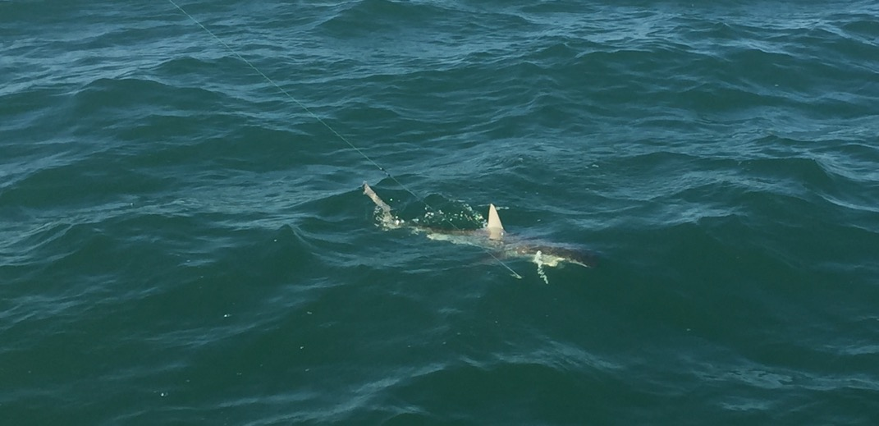
Applying Telemetry Data to Decision-Making
Dr. Charles Bangley
Postdoctoral Fellow, Dalhousie University
FORCE Risk Assessment Program

Slide 2
Topics Covered
Factoring the type of question into telemetry studies
Applying telemetry results
Case studies of telemetry results applied to decision-making

Slide 3
Types of Questions
The type of question can influence your whole workflow
Descriptive Questions
How many individuals of this species are in the local environment?
What seasonal and environmental conditions are associated with presence?
Where does this species go when it’s not locally present?
Hypothesis-Driven Questions
Are there differences in migration or presence by sex, size, etc.?
How might this species interact with fisheries, infrastructure, etc.?
How will environmental changes affect the local presence of this species?

Slide 4
Types of Questions
The type of question can influence your whole workflow
Descriptive
Hypothesis-Driven
Deploy Tags and Receivers
Apply Questions
Basic Analysis
Question-Specific Deployment
Existing Data Sets
Apply Questions
Analysis
Question-Specific Analysis
Answer Questions

Slide 5
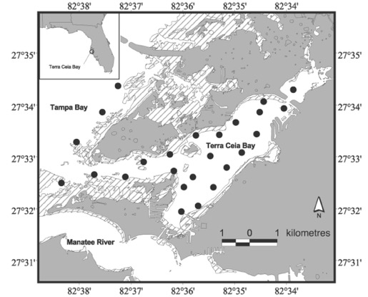
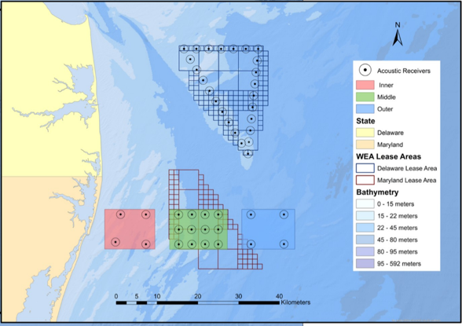
Types of Questions
The type of question can influence deployment strategies
Tag everything you can or target specific sexes, life stages, etc.?
Maximize receiver coverage area or target specific sites?
Long-term vs. short-term data collection
Even Receiver Coverage
Targeted Receiver Coverage
Heupel, M.R. and C. A. Simpfendorfer. 2002. Estimation of mortality of juvenile blacktip sharks Carcharhinus limbatus, within a nursery area using telemetry data. Canadian Journal of Fisheries and Aquatic Sciences 59: 624-632.
Rothermel, E. R., M. T. Balazik, J. E. Best, M. W. Breece, D. A. Fox, B. I. Gahagan, D. E. Haulsee, A. L. Higgs, M. H. P. O’Brien, M. J. Oliver, I. A. Park, and D. H. Secor. 2020. Comparative migration ecology of striped bass and Atlantic sturgeon in the US southern Mid-Atlantic Bight flyway. PLOS One 15: e0234442.

Slide 6
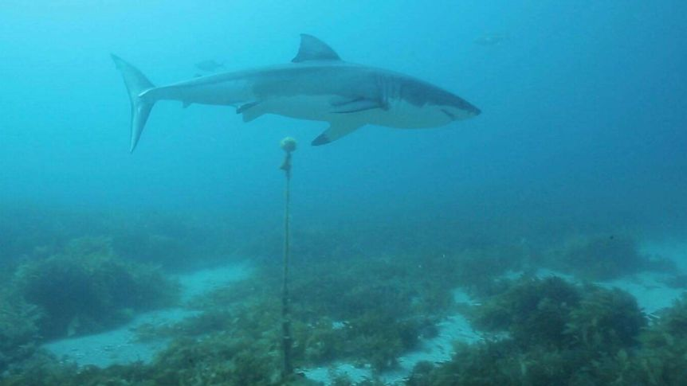
Types of Questions
The type of question can influence the choice of telemetry variables
Presence – at a given receiver or within a given area
Often summarized over periods of time (i.e. daily presence)
Can be used as presence/absence records for habitat models
Abundance – number of individuals detected
Also often summarized over a period of time (n per month)
Also used in habitat modeling
Finding Salisbury, Inc.

Slide 7
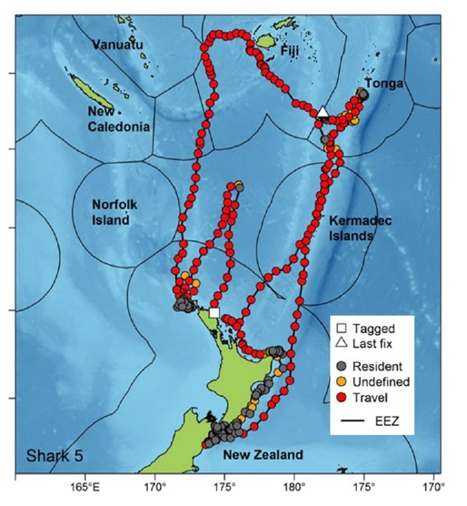
Types of Questions
The type of question can influence the choice of telemetry variables
Residence time – time spent at a receiver/location
Used to identify site fidelity to potentially important habitat
Movement behavior – inferred from variables related to travel between consecutive detections
Movement Behavior States
Variables include distance traveled, turning angle, velocity of travel
Designate use of different areas – migratory vs. resident habitat
Francis, M. P., M. S. Shivji, C. A. J. Duffy, P. J. Rogers, M. E. Byrne, B. M. Wetherbee, S. C. Tindale, W. S. Lyon, and M. S. Meyers. 2018. Oceanic nomad or coastal resident? Behavioral switching in the shortfin mako shark (Isurus oxyrhinchus). Marine Biology 166:5

Slide 8
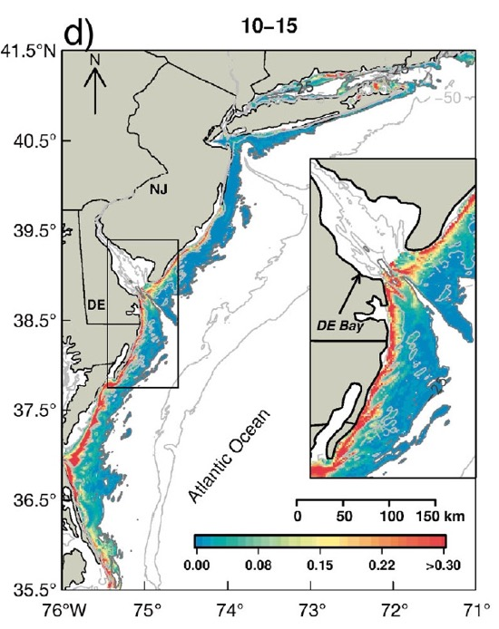
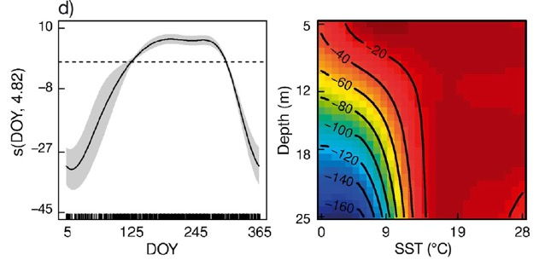
Applying Telemetry
Applied uses of telemetry results
Species distribution and environmental associations
Likelihood of overlap with fishing activity, shipping, offshore infrastructure
Designating important/protected habitat
Documenting range extent/shifts
Modeled Habitat
(Presence Likelihood)
Environmental Associations
Haulsee D. E., M. W. Breece, L. M. Brown, B. M. Wetherbee, D. A. Fox, and M. J. Oliver. 2018. Spatial ecology of Carcharias taurus in the northwestern Mid-Atlantic coastal ocean. Marine Ecology Progress Series 597: 191-206.

Slide 9
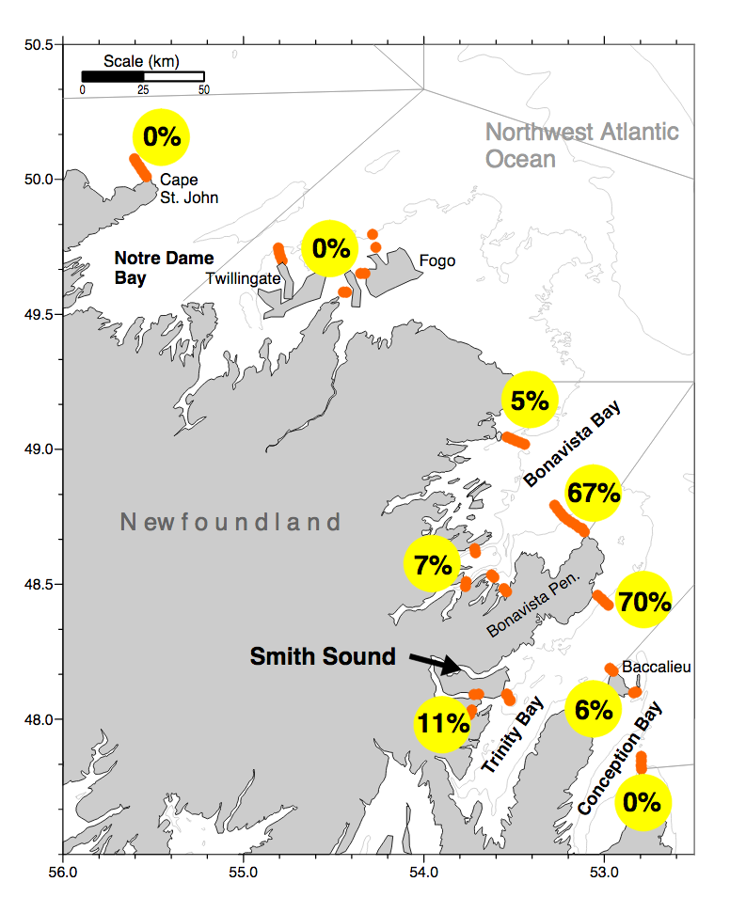
Applying Telemetry
Applied uses of telemetry results
Migratory routes and connections
Stock/population delineation and structure
Dispersal of particular stocks
Identifying areas where conservation efforts are needed
% of Fish From Release Site Detected
Brattey, J., B. Healey, and D. Porter. 2008. Northern cod (Gadus morhua) 16 years after the moratorium: new information from tagging and acoustic telemetry. Canadian Science Advisory Secretariat Research Document 2008/047.

Slide 10
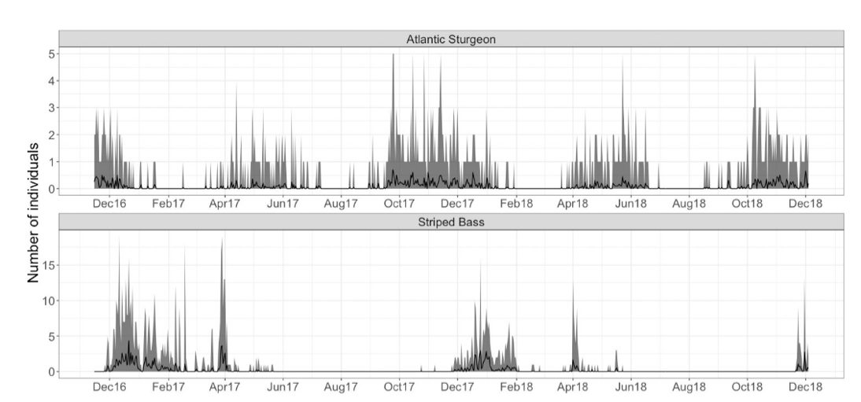
Applying Telemetry
Applied uses of telemetry results
Seasonal presence and abundance
Designating fishing seasons, time/area closures
Timing restrictions on shipping vessel speed, marine construction
Daily Presence Within the Area of Interest
Rothermel, E. R., M. T. Balazik, J. E. Best, M. W. Breece, D. A. Fox, B. I. Gahagan, D. E. Haulsee, A. L. Higgs, M. H. P. O’Brien, M. J. Oliver, I. A. Park, and D. H. Secor. 2020. Comparative migration ecology of striped bass and Atlantic sturgeon in the US southern Mid-Atlantic Bight flyway. PLOS One 15: e0234442.

Slide 11
Applying Telemetry
Applied uses of telemetry results
Movement behavior
Identifying important habitats based on behavioral changes
Animals “slow down” in foraging and nursery habitats
Survivorship and sublethal effects of capture
Movement Behavior at Different Areas of the Migratory Range
Ogburn, M. B., C. W. Bangley, R. Aguilar, R. A. Fisher, M. C. Curran, S. F. Webb, and A. H. Hines. 2018. Migratory connectivity and philopatry of cownose rays Rhinoptera bonasus along the Atlantic coast, USA. Marine Ecology Progress Series 602: 197-211.

Slide 12
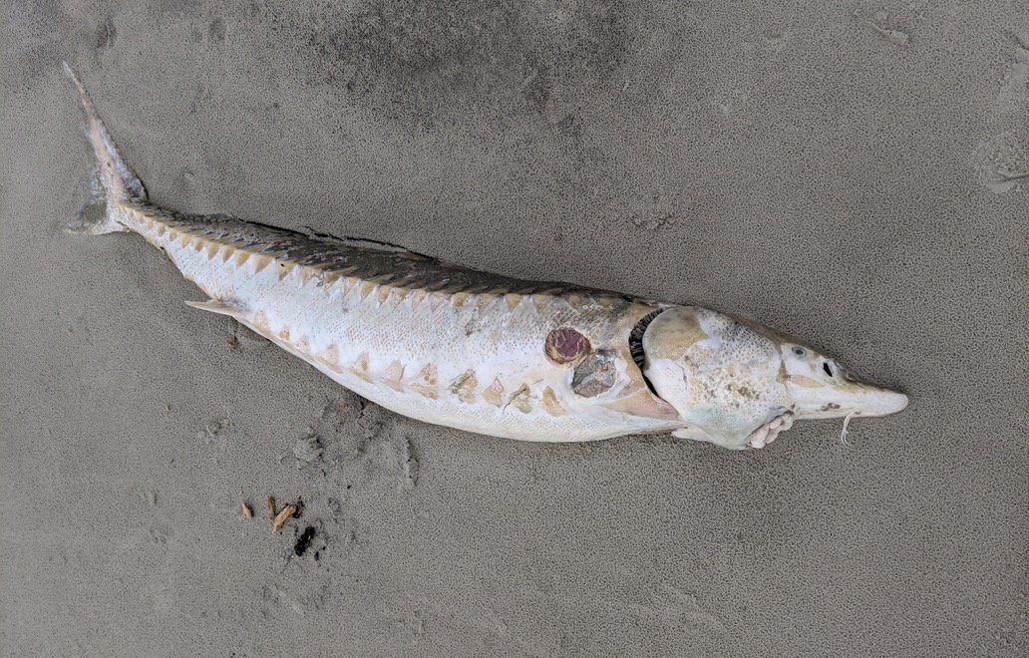
Case Study – Atlantic Sturgeon in Delaware Bay
The problem – vessel strikes on a vulnerable population of Atlantic sturgeon
Dan Wagoner

Slide 13
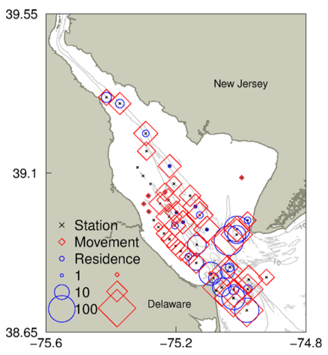
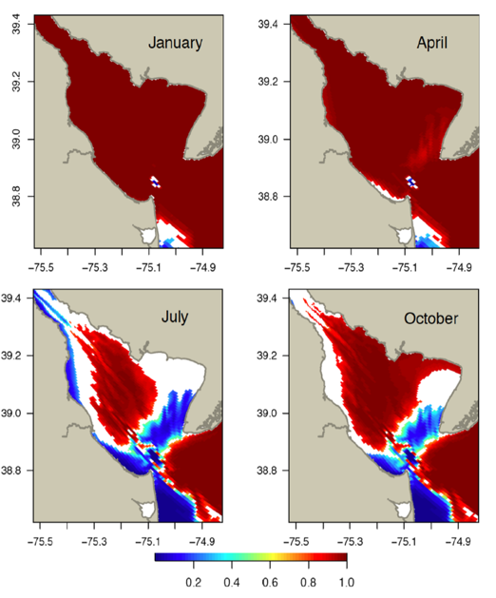
Case Study – Atlantic Sturgeon in Delaware Bay
Breece et al. (2018) – used combination of presence and movement behavior from telemetry data to model areas of residence
Identified potential critical habitat near the bay mouth
Results can be used to establish protected areas and control vessel traffic
Breece, M. W., D. A. Fox, and M. J. Oliver. 2018. Environmental drivers of Atlantic sturgeon movement and residency in the Delaware Bay. Marine and Coastal Fisheries 10: 269-280

Slide 14
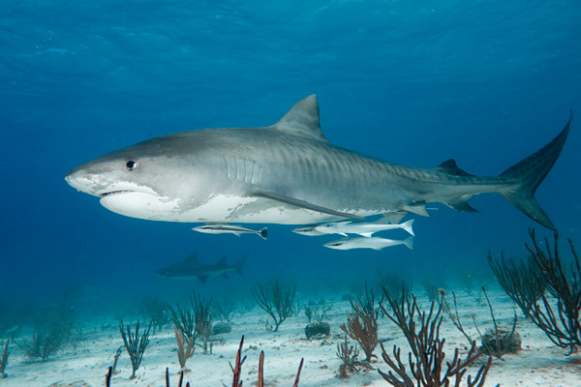
Case Study – Protected Areas for Highly Migratory Sharks
The problem – Uncertainty of the effectiveness of protected areas for highly migratory species (sharks in this case)
Andy Murch

Slide 15
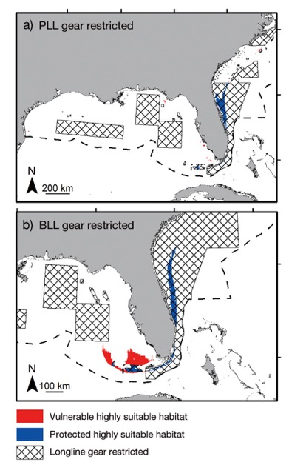
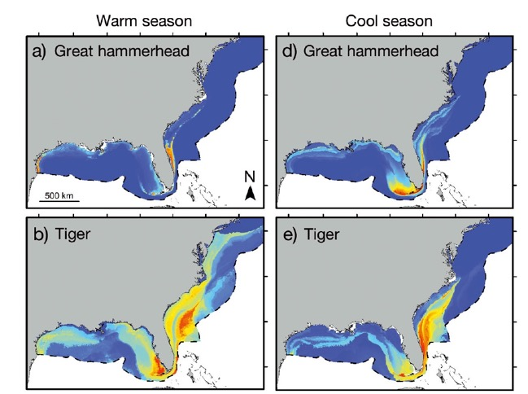
Case Study – Protected Areas for Highly Migratory Sharks
Calich et al. (2018)
Modeled habitat suitability for three shark species (great hammerhead, tiger, bull) from satellite telemetry positions and environmental data
Assessed overlap between highly suitable habitat and areas with restricted longline fishing
Calich, H., M. Estevanez, N. Hammerschlag. 2018. Overlap between highly suitable habitats and longline gear management areas reveals vulnerable and protected regions for highly migratory sharks. Marine Ecology Progress Series 602: 183-195.

Slide 16
Case Study – Protected Areas for Highly Migratory Sharks
Bangley et al. (In Press) – applied a similar approach using acoustic telemetry to assess dusky shark overlap with offshore development and restricted areas
Receiver networks make satellite telemetry-like coverage possible
Bangley, C.W., T.H. Curtis, D.H. Secor, R.J. Latour, and M.B. Ogburn. In Press. Identifying important Dusky Shark habitat in the Northwest Atlantic Ocean using acoustic telemetry and spatial modeling. Marine and Coastal Fisheries

Slide 17
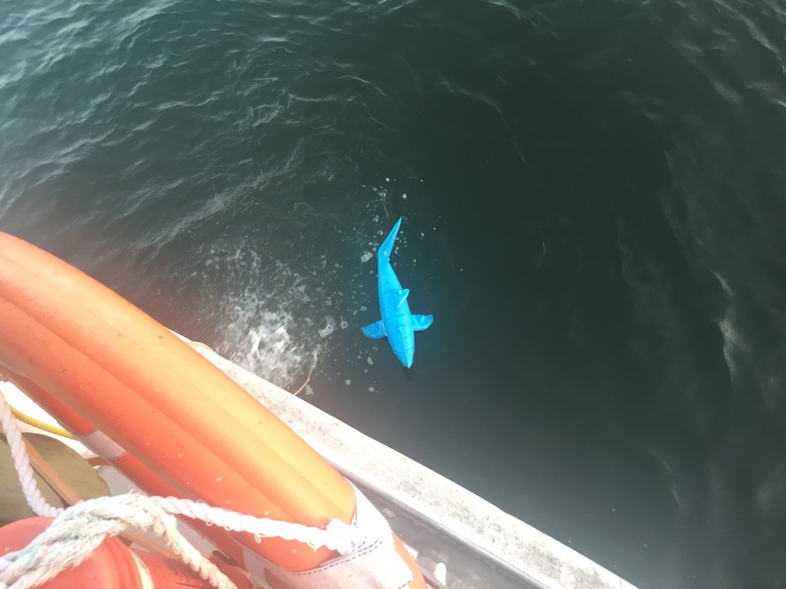
Questions?

